Slide 1

Applied Data Science Capstone
Gabriel Valverde
27/08/2022
https://github.com/gabriel-jap/Data-Science

Slide 2
Index
Executive Summary
Introduction
Methodology
Results
Conclusion

Slide 3

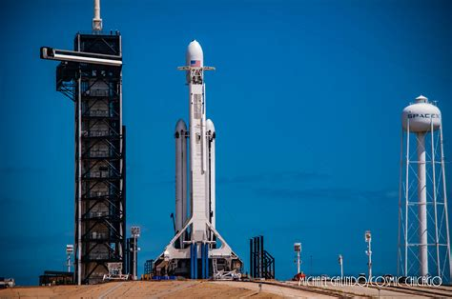
EXECUTIVE SUMMARY
In order to finish the course of Data Science by Coursera. I had to examine information about SpaceX landings and share my Insights.
Data was extracted from the SpaceX API and Wikipedia, in order to analyze the successful landings and how the parameters change the outcome.
Then, various Machine Learning models were developed in order to predict a future landing.

Slide 4
Introduction
SpaceX has a notorious advantage in the commercial Space business thanks to its low prices (62 million dollars vs. more than 165 million of the other providers). That's because of the reusability of the first part of the spaceship.
Space Y wants to compete against it, so I was tasked to examine the data and presents my findings, and then create an ML model to predict the outcome of the first stage landing.

Slide 5
METHODOLOGY
The data was provided by the SpaceX API and enriched with tables from Wikipedia’s articles.
Origin of Data

Slide 6
SpaceX API: Selecting Features
https://github.com/gabriel-jap/Data-Science/blob/main/jupyter-labs-spacex-data-collection-api.ipynb
Divide in features
Date
Booster Version
Payload Mass
Orbit
Launch Site
Outcome
Flights
Grid Fins
Reused
Legs
Landing Pad
Block
Reused Count
Serial
Longitude
Latitude
Select important Information
rocket
payloads
launchpad
cores
flight_number
date_utc
Full Response of the request API

Slide 7
SpaceX API: Wrangling Information
https://github.com/gabriel-jap/Data-Science/blob/main/jupyter-labs-spacex-data-collection-api.ipynb
Dataset
Date
Booster Version
Payload Mass
Orbit
Launch Site
Outcome
Flights
Grid Fins
Reused
Legs
Landing Pad
Block
Reused Count
Serial
Longitude
Latitude
Booster Version
Keep records of Falcon 9 Only
Payload Mass
Deal with missing data by filling them with the mean

Slide 8
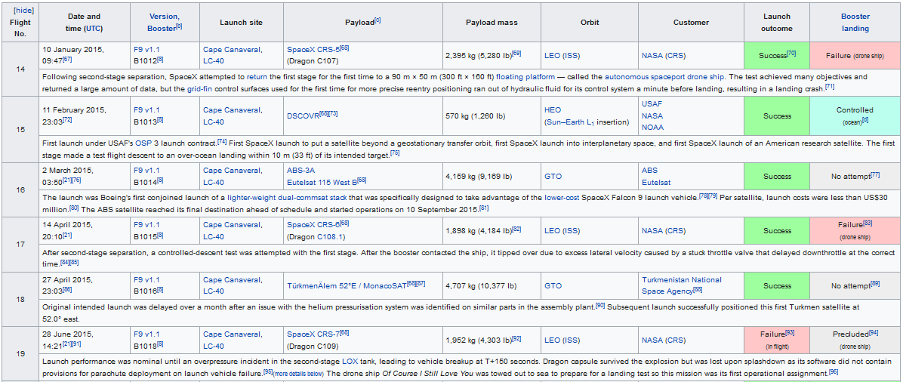
Wikipedia: Web scraping
https://github.com/gabriel-jap/Data-Science/blob/main/jupyter-labs-webscraping.ipynb
From
We took the tables
https://en.wikipedia.org/w/index.php?title=List_of_Falcon_9_and_Falcon_Heavy_launches&oldid=1027686922

Slide 9
Wikipedia: Web scraping
https://github.com/gabriel-jap/Data-Science/blob/main/jupyter-labs-webscraping.ipynb
First, the column’s titles are scraped
Then, the information in each cell is extracted and assigned to the correspondent list.
14
10 January 2015
09:47
F9 v1.1
Cape Canaveral
SpaceX CRS-5
2,395 kg
LEO
NASA
Success
Failure

Slide 10
METHODOLOGY
¿How we decide what is a successful landing?
Data Wrangling

Slide 11
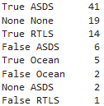
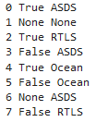
Data Wrangling: Creating the “Class” column
https://github.com/gabriel-jap/Data-Science/blob/main/labs-jupyter-spacex-Data%20wrangling.ipynb
First we see the different outcomes of the missions and its frequency
We decide what will be a successful landing and assign a “1” and a “0” otherwise in a new column class
0 | True ASDS
1 | None None
2 | True RTLS
3 | False ASDS
4 | True Ocean
5 | False Ocean
6 | None ASDS
7 | False RTLS
1
0
1
0
1
0
0
0
Now we can define the different outcomes of the landings

Slide 12
METHODOLOGY
Process of examining the data, to later sho the findings
Analytics

Slide 13


METHODOLOGY: Analytics
It was used Python and SQL to realize some basic EDA such as:
Flight Number vs. Payload Mass Flight Number vs. Launch Site Payload Mass vs. Launch Site Orbit vs. Success Rate Flight Number vs. Orbit Payload vs Orbit Success Yearly Trend
With IBM Storege and SQL queries, more findings were sidcobered such as:
The different Booster Version abviable
The different outcomes in specific time windows
The average Payload mass by Booster
and the first successful landing
https://github.com/gabriel-jap/Data-Science/blob/main/jupyter-labs-eda-dataviz.ipynb
https://github.com/gabriel-jap/Data-Science/blob/main/jupyter-labs-eda-sql-coursera_sqllite.ipynb

Slide 14


METHODOLOGY: Analytics
Dash was used to plot interactive plots, and make new insights
The full code will be in the link below
With Folium was created an Interactive Map of the different Launch Sites, to see what infrastructure is needed
https://github.com/gabriel-jap/Data-Science/blob/main/spacex_dash_app.py
https://github.com/gabriel-jap/Data-Science/blob/main/lab_jupyter_launch_site_location.ipynb

Slide 15

METHODOLOGY: Predictive analysis
DATAFRAME
Train data and Outcomes
Test data
real outcome
First we split the data in training data, and testing data.
The test data, was divided it by its parameters and the outcome and then put it a side for a moment
https://github.com/gabriel-jap/Data-Science/blob/main/SpaceX_Machine%20Learning%20Prediction_Part_5.ipynb

Slide 16
METHODOLOGY: Predictive analysis
Then we train the models with the Train parameters to find an accurate way to predict the outcome.
Thanks to GridSearchCV each model is given a certain liberty to adjust it function in order to find the best configuration and the best way to predict the outcome
Train data and Outcomes
Knn
Log
Reg
SVM
Tree
https://github.com/gabriel-jap/Data-Science/blob/main/SpaceX_Machine%20Learning%20Prediction_Part_5.ipynb

Slide 17

METHODOLOGY: Predictive analysis
Then the models try to predict the outcome of the parameters of the test data and is later compared to the real outcome to see the accuracy of the model
Knn
Predicted Outcome
real outcome
Log
Reg
Predicted Outcome
real outcome
Test data
SVM
Predicted Outcome
real outcome
Tree
Predicted Outcome
real outcome
https://github.com/gabriel-jap/Data-Science/blob/main/SpaceX_Machine%20Learning%20Prediction_Part_5.ipynb

Slide 18
Analytics
Exploratory Analysis with SQL and Python
Interactive Analysis with Dash and Folium

Slide 19
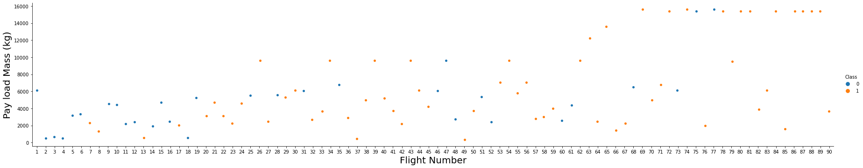
Exploratory Analysis with Python
https://github.com/gabriel-jap/Data-Science/blob/main/jupyter-labs-eda-dataviz.ipynb
First, let's try to see how the Flight Number (indicating the continuous launch attempts.) and Payload variables would affect the launch outcome.
We see that as the flight number increases, the landing is more likely to occur.
Meanwhile, it seems, the more massive the payload, the less likely the first stage will return.

Slide 20
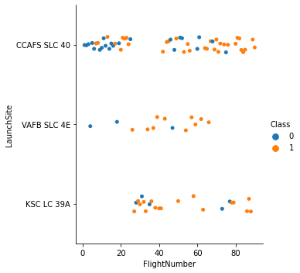
Exploratory Analysis with Python
https://github.com/gabriel-jap/Data-Science/blob/main/jupyter-labs-eda-dataviz.ipynb
Here we see the different outcomes divided by the Launch Site as the times goes by.
We see how frequent the launches at CCAFS SLC 40 are, and how in near this time the VAFB SLC 4E it falls practically unused

Slide 21
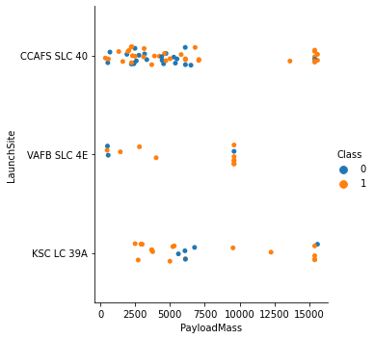
Exploratory Analysis with Python
https://github.com/gabriel-jap/Data-Science/blob/main/jupyter-labs-eda-dataviz.ipynb
Here we see the different outcomes divided by the Payload Mass, and it Launches site
We see the VAFB-SLC launch site there are no rockets launched for heavy payload mass(greater than 10000).

Slide 22
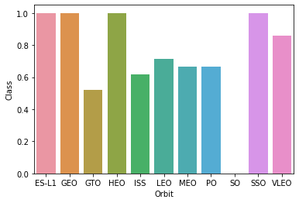
Exploratory Analysis with Python
https://github.com/gabriel-jap/Data-Science/blob/main/jupyter-labs-eda-dataviz.ipynb
Now let’s check if there are any relationship between success rate and orbit type
As we can see, ES-L1, GEO, HEO and SSO had the most successful landings

Slide 23
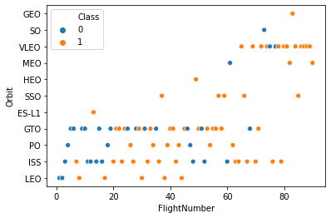
Exploratory Analysis with Python
https://github.com/gabriel-jap/Data-Science/blob/main/jupyter-labs-eda-dataviz.ipynb
We saw that some orbits have a high rate of success, and that later landings were more successful. It could be that the good outcomes comes from more developed technology instead of a characteristic of the orbit itself?
To probe it, let's plot the Orbit against the flight number
ES-L1: There’s no enogh evidence to prove anything
GEO: There’s no enogh evidence to prove anything
HEO: There’s no enough evidence to prove anything
SSO: Its successfulness is proven against the times
Side Note:
Leo shows and increase in good outcomes by the times goes by.

Slide 24
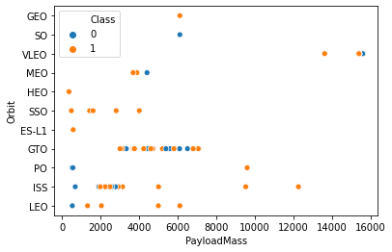
Exploratory Analysis with Python
https://github.com/gabriel-jap/Data-Science/blob/main/jupyter-labs-eda-dataviz.ipynb
Here it shows how with heavy payloads the successful landing rate are more for Polar,LEO and ISS.
However, for GTO we cannot distinguish this well since good and bad outcomes are mixed

Slide 25
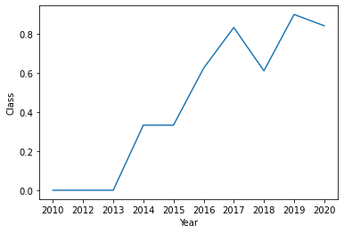
Exploratory Analysis with Python
https://github.com/gabriel-jap/Data-Science/blob/main/jupyter-labs-eda-dataviz.ipynb
And lastly, we see an improvement in the outcomes of landings as times goes by

Slide 26
Exploratory Analysis with SQL
https://github.com/gabriel-jap/Data-Science/blob/main/jupyter-labs-eda-sql-coursera_sqllite.ipynb
failed landing_outcomes in drone ship, their booster versions, and launch site names for in year 2015
count of landing outcomes (such as Failure (drone ship) or Success (ground pad)) between the date 2010-06-04 and 2017-03-20, in descending order

Slide 27
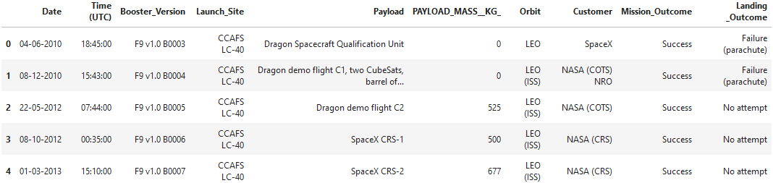
Exploratory Analysis with SQL
https://github.com/gabriel-jap/Data-Science/blob/main/jupyter-labs-eda-sql-coursera_sqllite.ipynb
Names of the unique launch sites in the space mission
['CCAFS LC-40',
'VAFB SLC-4E',
'KSC LC-39A',
'CCAFS SLC-40']
5 records where launch sites begin with the string 'CCA'

Slide 28
Exploratory Analysis with SQL
https://github.com/gabriel-jap/Data-Science/blob/main/jupyter-labs-eda-sql-coursera_sqllite.ipynb
total payload mass carried by boosters launched by NASA (CRS)
99980 Kg
average payload mass carried by booster version F9 v1.1
2534.6666666666665

Slide 29
Exploratory Analysis with SQL
https://github.com/gabriel-jap/Data-Science/blob/main/jupyter-labs-eda-sql-coursera_sqllite.ipynb
Date when the first successful landing outcome in ground pad was achieved.
'06-05-2016'
Names of the boosters which have success in drone ship and have payload mass greater than 4000 but less than 6000
['F9 FT B1022',
'F9 FT B1026',
'F9 FT B1021.2',
'F9 FT B1031.2']

Slide 30
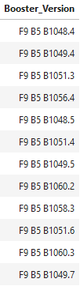

Exploratory Analysis with SQL
https://github.com/gabriel-jap/Data-Science/blob/main/jupyter-labs-eda-sql-coursera_sqllite.ipynb
Total number of successful and failure mission outcomes
Names of the booster_versions which have carried the maximum payload mass.

Slide 31
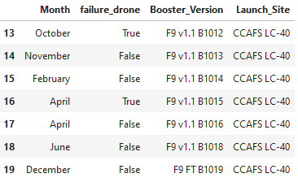
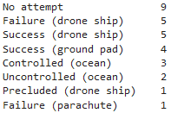
Exploratory Analysis with SQL
https://github.com/gabriel-jap/Data-Science/blob/main/jupyter-labs-eda-sql-coursera_sqllite.ipynb
Failed landing_outcomes in drone ship, their booster versions, and launch site names for in year 2015
Count of landing outcomes (such as Failure (drone ship) or Success (ground pad)) between the date 2010-06-04 and 2017-03-20, in descending order

Slide 32
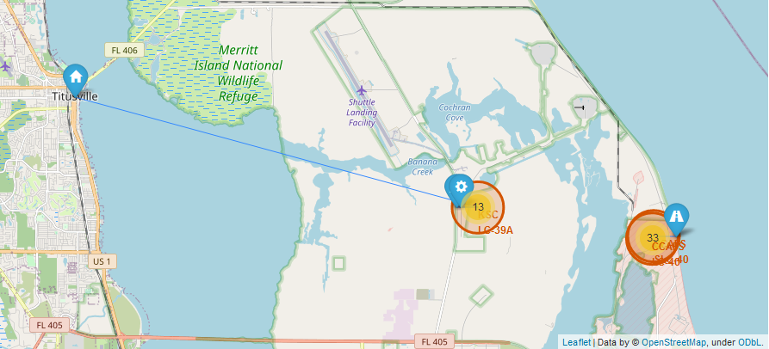
Interactive Analysis with Folium
https://github.com/gabriel-jap/Data-Science/blob/main/lab_jupyter_launch_site_location.ipynb
As always, the access to the GitHub Notebook is in the top of the slide

Slide 33
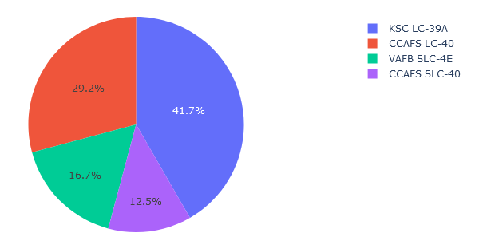
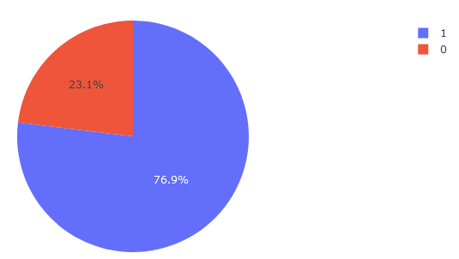
Interactive Analysis with Dash
https://github.com/gabriel-jap/Data-Science/blob/main/spacex_dash_app.py
Here we can see that a big part of the Lunch sites were in KSC LC-39A. And that’s not something odd, since KSC LC-39A is the launch site with more successful missions of all the sites, as we can see in the second graph.

Slide 34
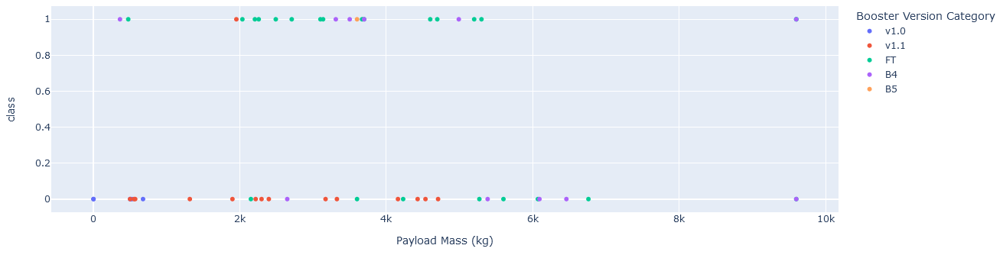
Interactive Analysis with Dash
https://github.com/gabriel-jap/Data-Science/blob/main/spacex_dash_app.py
We can see a trend of successful landings when the Payload is in between 2000 and 5500 kg, especially with the Boosters FT

Slide 35
Predictive analysis

Slide 36
Developed Models
Desicion tree
Hyperparameters:
'criterion': 'gini'
'max_depth': 12
'max_features': 'sqrt'
'min_samples_leaf': 2
'min_samples_split': 10
'splitter': 'best'
with an accuracy : 0.8472222222222222
KNN
Hyperparameters:
'algorithm': 'auto'
'n_neighbors': 10
'p': 1
with an accuracy : 0.8472222222222222
logistic regression
Hyperparameters:
'C': 0.01
'penalty': 'l2',
'solver': 'lbfgs'
with an accuracy : 0.8472222222222222
SVM
Hyperparameters:
'C': 1.0
'gamma': 0.03162277660168379
'kernel': 'sigmoid'
with an accuracy : 0.8472222222222222

Slide 37
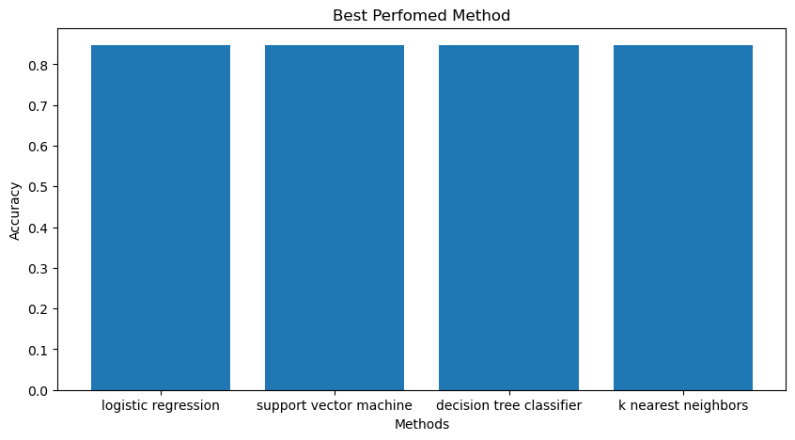

Slide 38
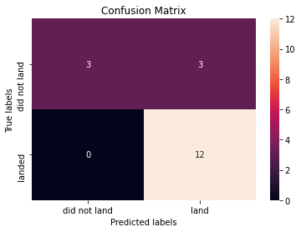
84% of accuracy
With a accuracy of 84% in the predictions we see that the models have a tendency to label correctly a correct landing, but it lack in accuracy when the outcome is negative

Slide 39
OVERALL FINDINGS & IMPLICATIONS
With this analysis, I conclude that the most successful parameters were:
Launch Site: KSC LC 39A
FT Boosters
Payload Mass between 2000 and 5500 kg

Slide 40
OVERALL FINDINGS & IMPLICATIONS
We can take advantage of the predicting model and the analysis’s insights to make more informed bids against SpaceX for a rocket launch. However, we lack in precision to predict bad outcomes in landings with the actual data, so is preferred to collect more data about bad outcomes to train the model before to implement to the decision-making

